Slide 1



Presented By
Karto Womenker
Hema Tiriveedi
Jyothirmayee kothakota
Sales Prediction

Slide 2
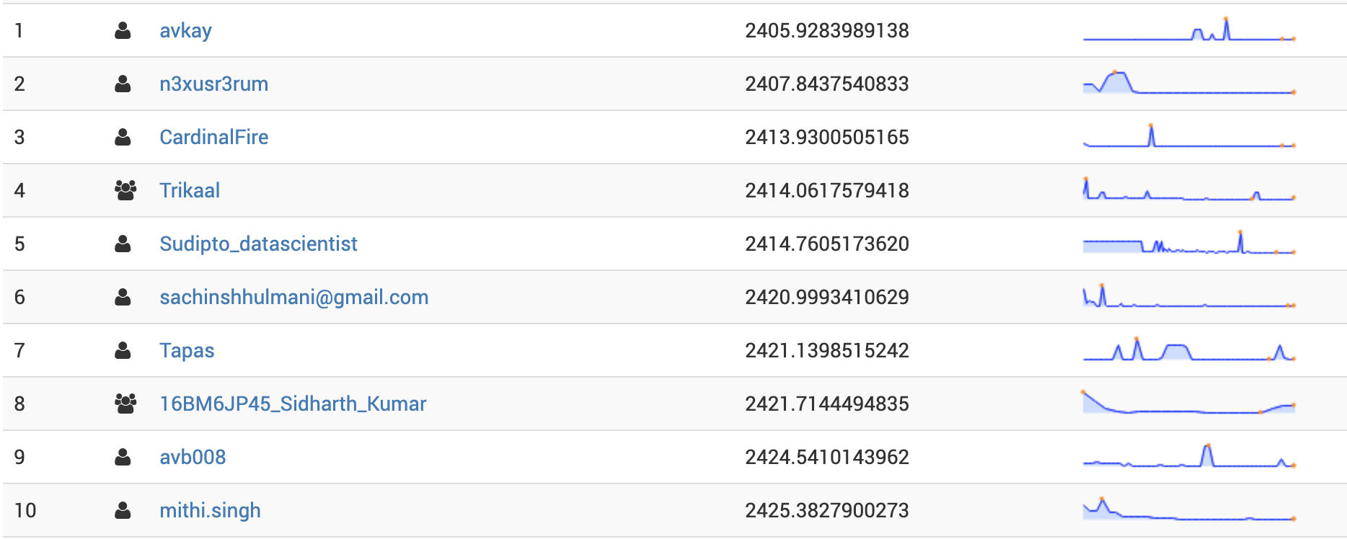

Source of Project

Slide 3
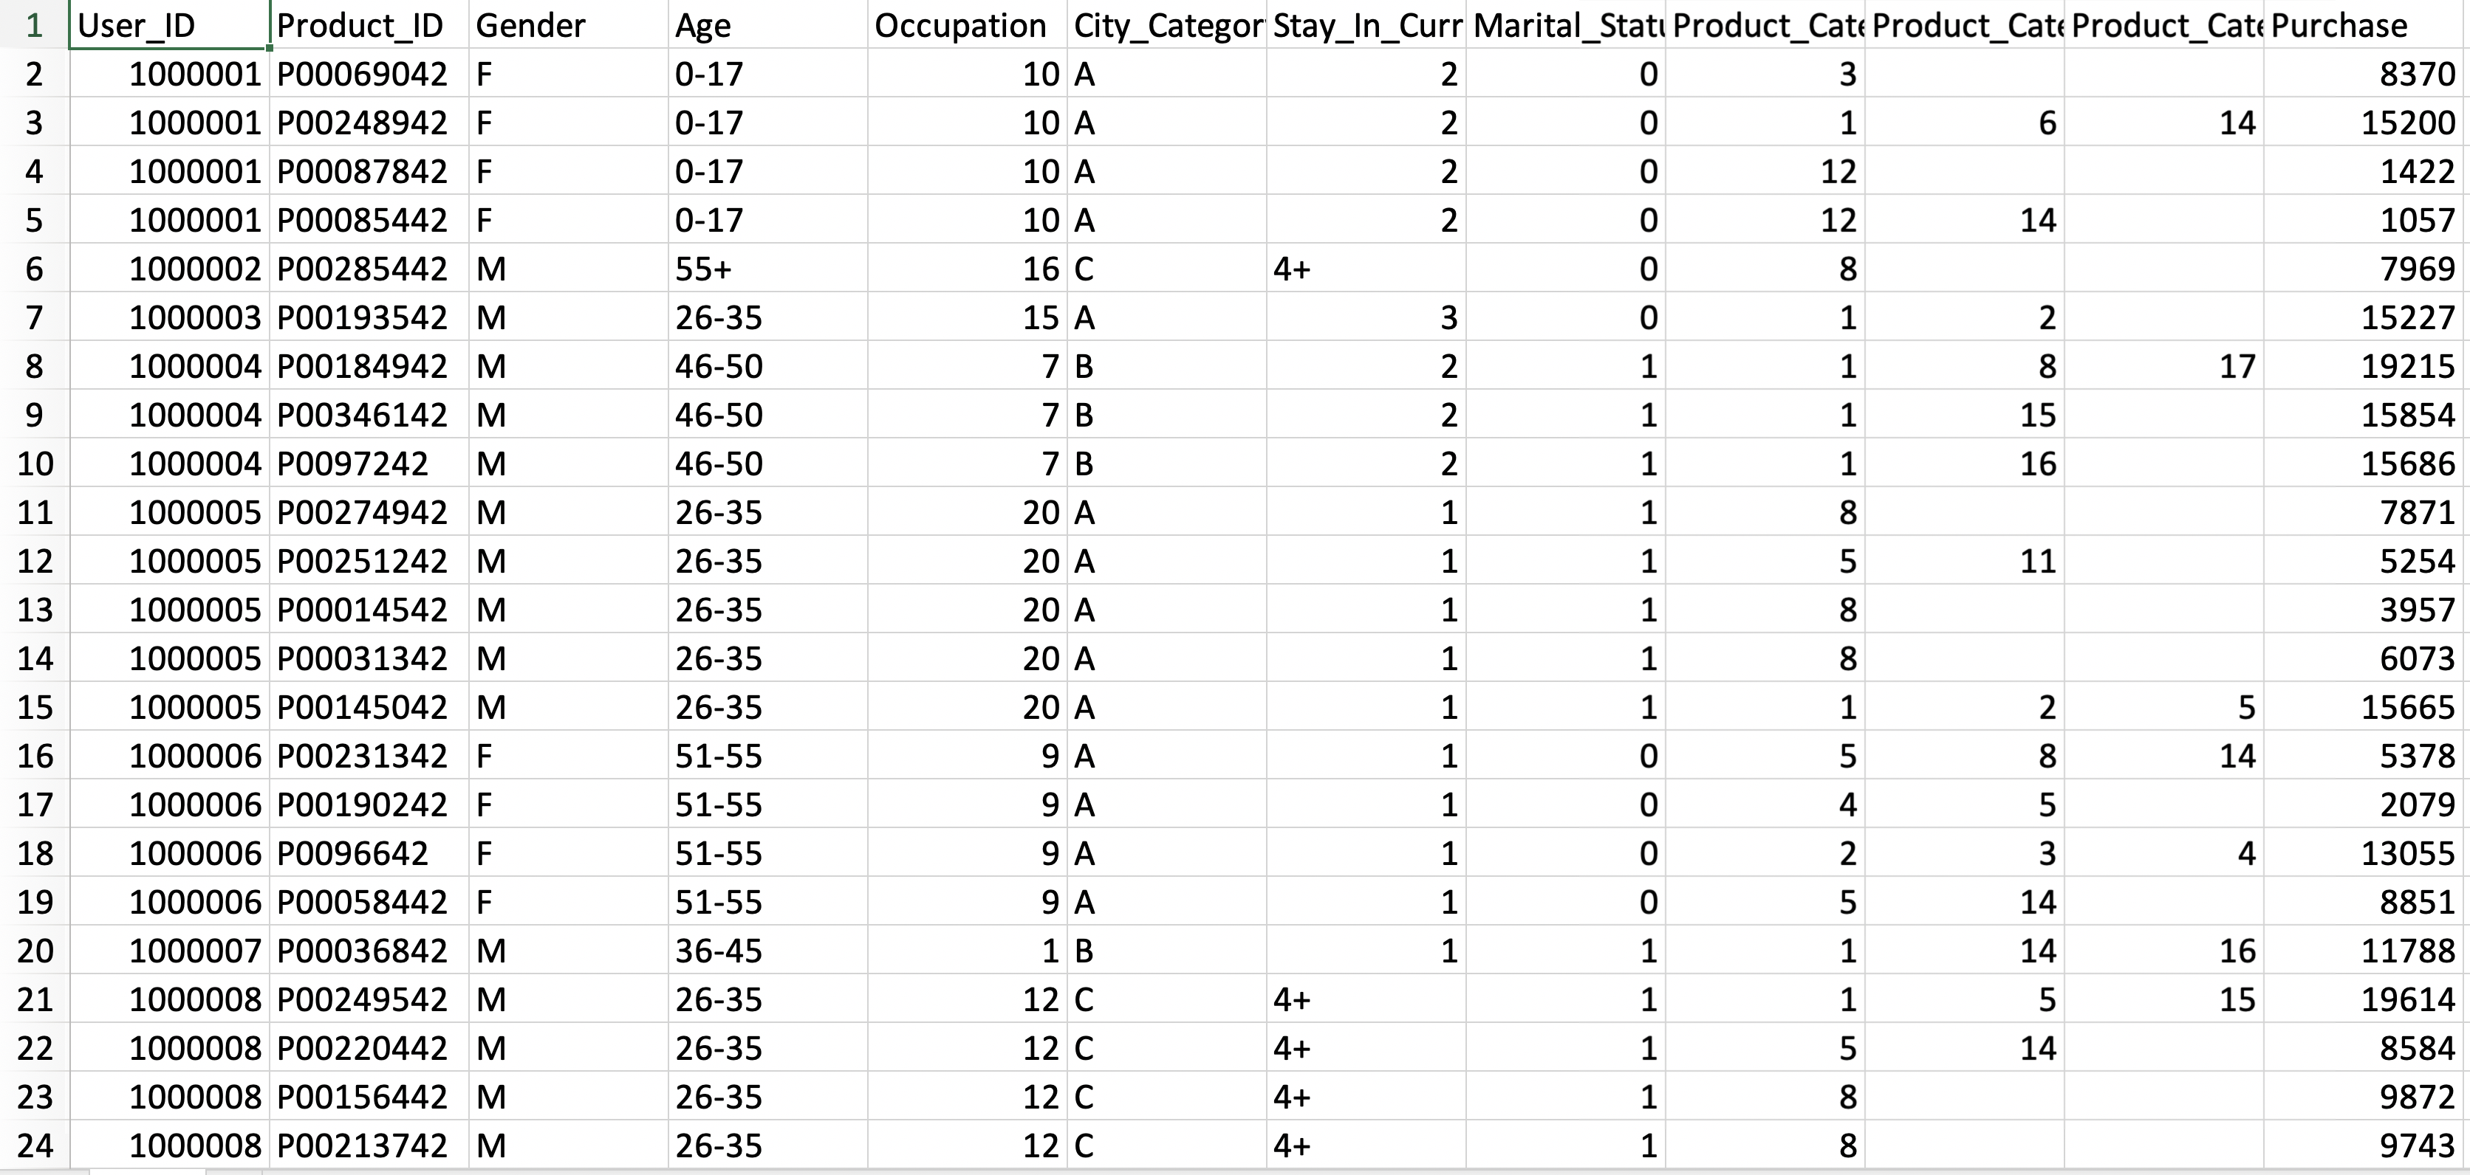
D
A
T
A
S
E
T

Slide 4
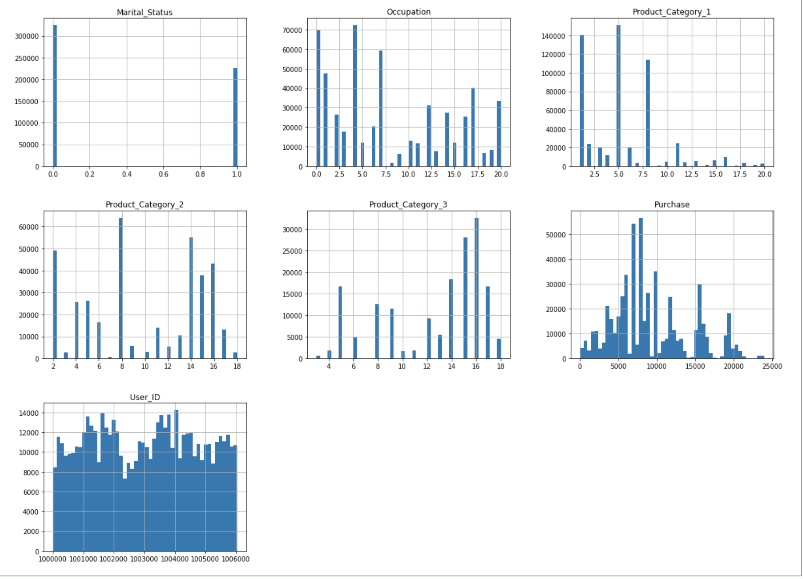
Graphical Representation Of Predictors

Slide 5
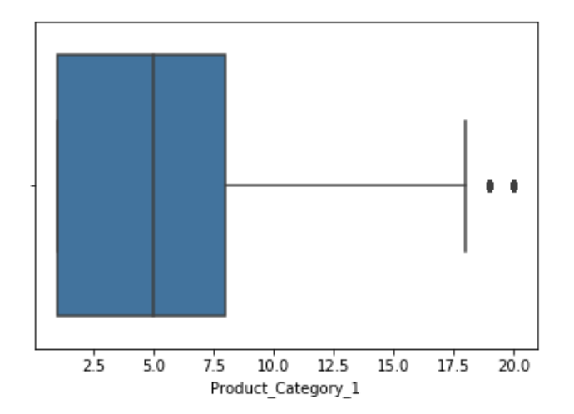
Improving The Model
Changing Categorical variables to Numerical variables.
One hot encoding is a process by which categorical variables are converted into a form that could be provided to Machine Learning algorithms to do a better job in prediction
Removing the Outliers

Slide 6
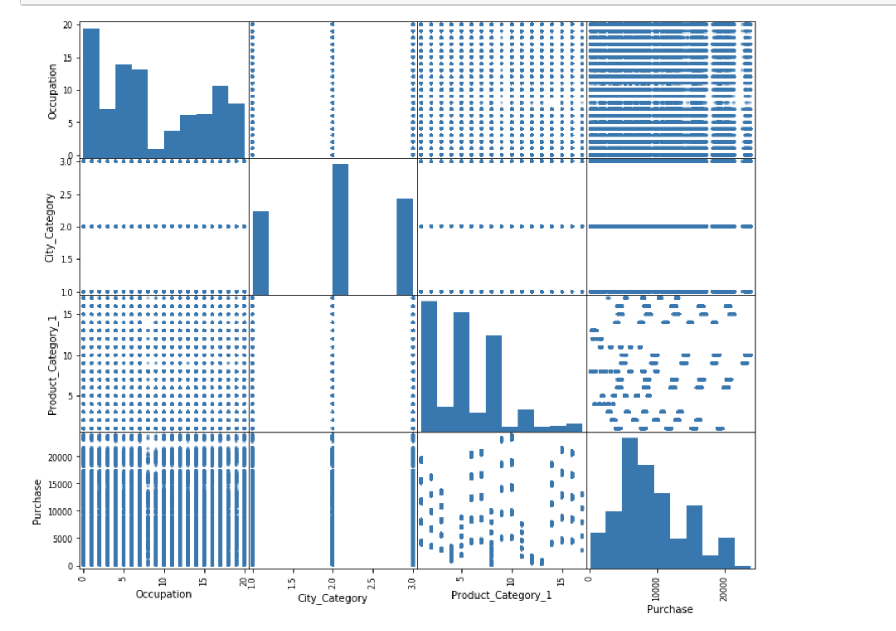
Scatter Plot

Slide 7
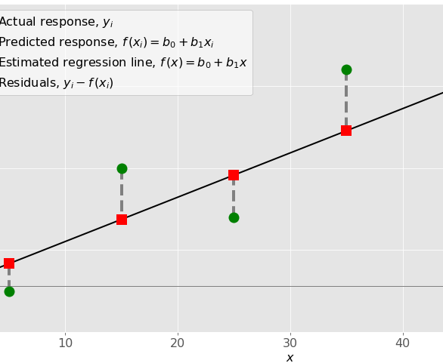
Linear Regression Algorithm
It is a linear approach to modelling the relationship between a scalar response and one or more explanatory variables.
One explanatory variable is called simple linear regression. More than One is called Multiple Regression
Y=mx+c

Slide 8
Building The Linear Model
RMSE: 4629
R-Squared: 0.1529
Mean Absolute Error : 3535

Slide 9
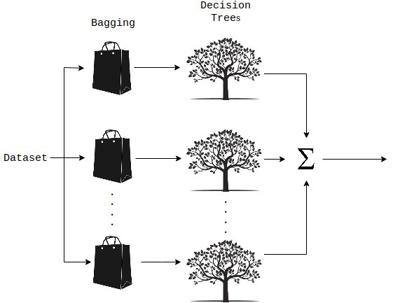
Random Forest Algorithm
Ensemble technique capable of performing both regression and classification tasks .
With the use of multiple decision trees and a technique called Bootstrap Aggregation.
We combine multiple decision trees in determining the final output rather than relying on individual decision trees.

Slide 10
Building The Random Forest Model
RMSE: 3087
R-Squared: 0.6233

Slide 11

Gradient Boost Algorithm
A Machine Learning Technique for Regression and Classification Problems
Boosting is a method of converting weak learners into strong learners.
Builds models in a stage wise Fashion
Each new tree is a fit on a modified version of the original data set.

Slide 12
Building The Gradient Boost Model
RMSE: 2980
R-Squared: 0.6488

Slide 13


